Slide 1
Feature selection for Alzheimer’s Disease - AIBL cohort
Ian Brettell
21 December 2017

Slide 2
SNP data
Our sample comprises individuals from the AIBL cohort
We have genotyped 181 of those individuals at 2,084 loci commonly associated with Alzheimer’s Disease (“AIBL SNPs”).
Of those 2,084 SNPs, 1,527 are in LD with other SNPs (“proxy SNPs”)
For a total of 18,118 unique proxy SNPs.
Using the Bioconductor ‘biomaRt’ package, we obtained:
the locations of the AIBL SNPs
for 2,075/2,084
Ensembl IDs and HGNC symbols for the genes in which they reside
1,994 of the AIBL SNPs reside in 621 unique genes
Followed the same process for the proxy SNPs.

Slide 3
SNP annotation info
 | AIBL SNPs | Proxy SNPs
Total genotyped | 2,084
No. in LD | 1,527 | 18,118
Loci identified | 2,075 | 17,847
Genes | 621 | 1,103
Unique genes (shared genes) | 127 (494) | 609 (494)

Slide 4
SNP association analysis
 | No. significant SNPs (p < 0.05) | Adjusted for multiple testing | No. genes mapped to by significant SNPs
Association (chi square, Fisher exact) | 72 SNPs mapping to 58 unique genes | 0 (from 10,000 permutations) | 58
Logistic regression with covariates | 87 SNPs mapping to 59 genes | 0 (< 0.05 FDR-adjusted) | 59
Intersection between above analyses | 4 | N/A | 16

Slide 5
eQTL analysis
 | No. significant SNPs (p < 0.05 FDR-adjusted) | No. differentially expressed genes | No. of SNPs acting in cis
Total cohort | 130 SNPs mapped to 101 genes | 2,242 | 8
AB-pos only | 28 SNPs mapped to 31 genes | 48 | 0
AB-neg only | 35 SNPs mapped to 34 genes | 74 | 0

Slide 6
SNP data
Next steps:
Incorporate AIBL cohort’s genotype data for future analysis with the expression data…

Slide 7
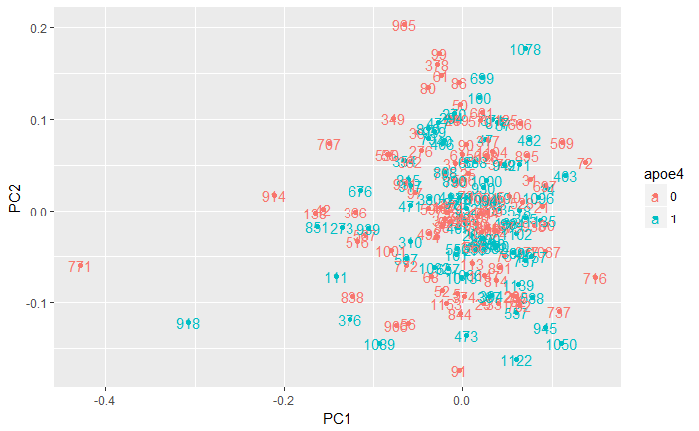
Expression data
We hold previously imported and normalised expression data from the Affymetrix HuEx-1_0-st-v2 platform (22,011 probe targets) for 218 individuals from the AIBL cohort.
Some individuals did not have the required metadata.
Exploratory PCA of the expression data also showed three outliers (AIBL Ids 771, 918, and 914).
Excluding those, we are left with N = 193

Slide 8
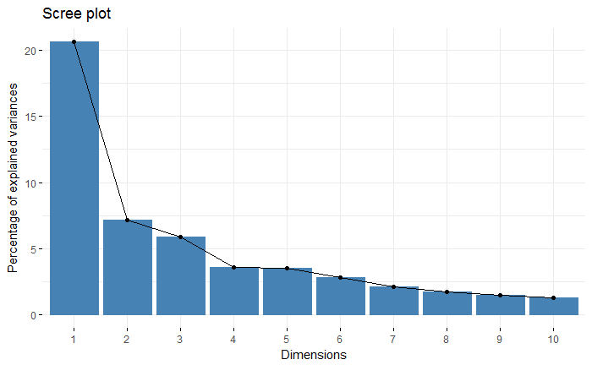
Expression data
First two principal components explain a large proportion of the variance in gene expression levels, so we can use PCA to detect clusters.

Slide 9
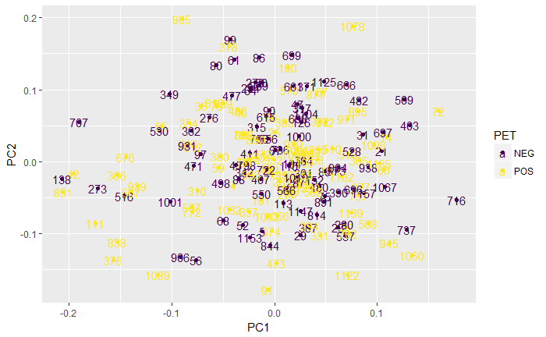
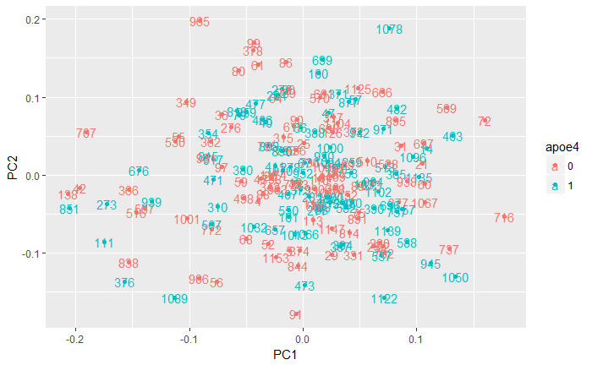
Expression data
No apparent clustering between the PET pos/neg or APOE4 allele pos/neg groups

Slide 10
Expression data
Using Bioconductor’s ‘limma’ package, we obtained the genes that were differentially expressed between six contrasts:
PET scan positive for amyloid buildup v PET scan negative (i.e. those with and without AD)
At least one apoe4 allele v no apoe4 allele
Between the apoe4 groups for individuals who were PET pos
Between the apoe4 groups for individuals who were PET neg
Between the PET groups for individuals who had at least one apoe4 allele.
Between the PET groups for individuals who did not have an apoe4 allele.

Slide 11
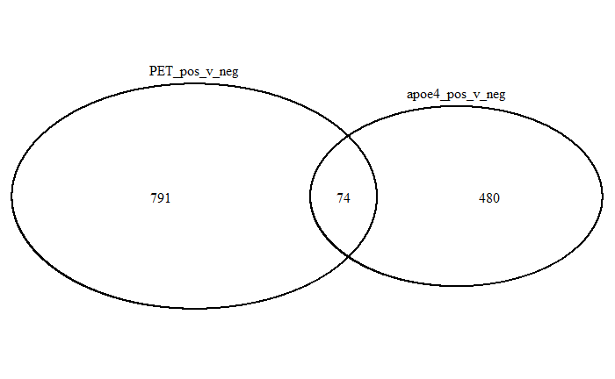
Expression data
865 genes differentially expressed between the PET pos and neg groups
554 genes differentially expressed between the apoe4 groups
74 shared

Slide 12
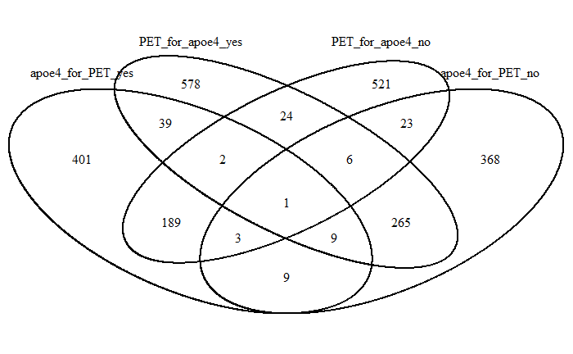
Expression data
Total of 2,438 genes differentially expressed in at least one of these four contrasts
265 genes may mediate the effects of apoe4?
189 genes may act independently of the apoe network to cause AD?

Slide 13
Expression data
Next steps:
Use the Bioconductor ‘gage’ package and ‘g:Profiler’ web tool to examine system networks that are being differentially expressed between those with and without AD.
Reconcile those networks with the AIBL SNPs and Proxy SNPs to find a relationship between expression levels and genotype.
Apply feature selection methods to determine whether some combination of expression patterns and genotypes can accurately predict AD.

